Slide 1



Everything is Awesome
…when you’re using Visual Studio Code
Mike Branstein
@mikebranstein
https://brosteins.com
Notes:
Thank you for attending. It’s been one year – to the day. VS Code was unleashed. Truthfully, when I sat at //build last year, I didn’t think VS Code that big of a deal, but over the last year, I’ve come to love VS code.
What I want you to get out of this talk is the basics of VS code, and the courage to download and try it for a few days. Then , tell me what you think.

Slide 2

Where to Find Me
https://brosteins.com
https://github.com/mikebranstein
@mikebranstein
@brosteins
@kizantech
Notes:
Where to find me…
So, I was inspired recently.
Now, I got really excited about Lego a few months ago, b/c my oldest son turned 4. For some reason, I thought a 4-yo could assemble a 2800-piece lego movie replica of the Sea Cow – that sweet pirate ship that metal beard flys. Why not, right?

Slide 3

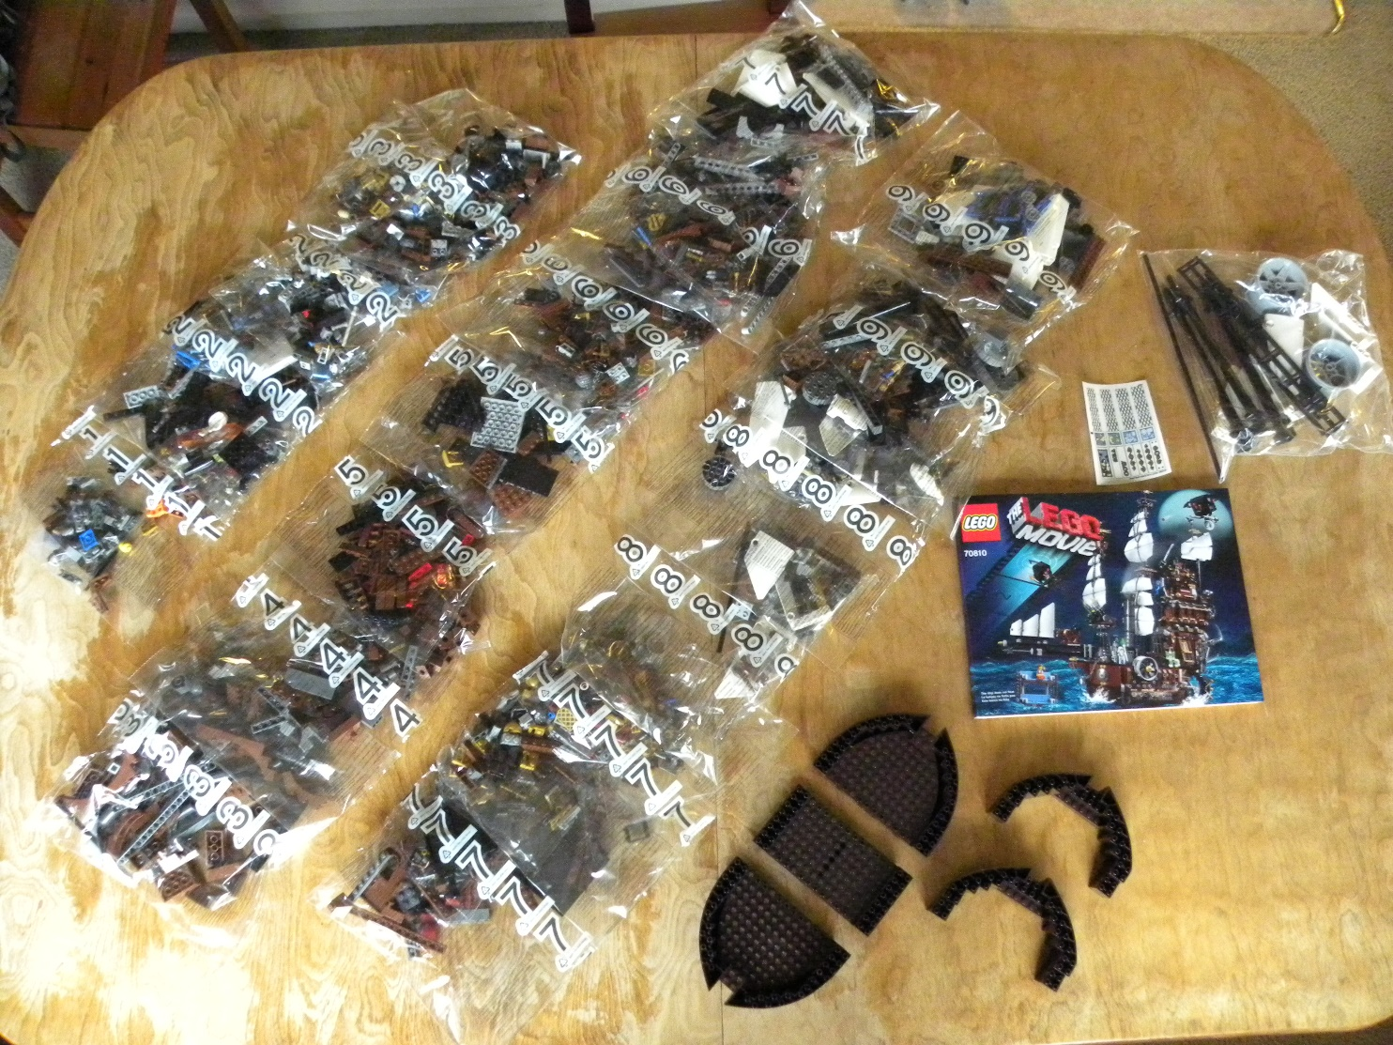
Father of the Year?
Notes:
So…this was a seriously bad idea. Here’s some advice – 4 yo’s don’t quite have the dexterity or finger strength to pick up teeny tiny pieces. So, the father of the year award almost immediately became, per my wife, loser husband of the year.
Now, to compound things, I wanted this to be a project my son built. Not me. (Although, let’s be real for a minute – this is a pretty sweet toy for dad…)
Then, something strange happened. After about a week, all the pieces just fit together – he got better at reading the directions, looking at the pictures, finding the pieces, and putting it together.

Slide 4
Everything is Awesome
…when you’re using Visual Studio Code
Notes:
…and then everything was awesome again!
Back to the inspiration – I like projects like the Sea Cow, because there’s so much to learn, and that’s why I picked up Visual Studio Code about 6 months ago. It’s new, and challenging. It challenges my brain because it’s different.
I’m a huge creature of habit. As I get older, I’m really a grumpy old man in his 30’s. But to get better and grow, I know I need to challenge myself. So VS Code was my way of challenging myself.
And I’m glad I did.

Slide 5
Why is Visual Studio Awesome?
Powerful IDE
Integrated Debugging
Extensibility
Team Collaboration
Multiple Languages
IntelliSense
Code Lens
F5 Debug
Remote Debugging
IntelliTrace
Add-ins
Extensions
TFS / VSTS
TFVC
Git
Notes:
So let’s start with Visual Studio – why do we love VS as .NET developers?

Slide 6

What is Visual Studio Code?
Why Another Editor?
Next Generation Editor with smarts – it’s NOT an IDE
When you need something fast – loads in a second
Cross-platform (Windows, OS X, Linux)
Simple, yet Powerful
Editor, with Multi-Language Support
Debugger
Integrated Source Control Management
Integrated Task Runner
Freedom from a 1 GB+ download and 2 hour install - VS Code is 28MB
Notes:
For all those reasons, we love Visual Studio. But what’s this stuff about Visual Studio Code?
I’ve already got VS? Why do I need something else?

Slide 7

Cross-Platform…Windows, OS X, & Linux?
How’d They Do That?
Electron Framework
Open-source framework developed by GitHub
Build Desktop/GUI apps with Node.js
Write in JavaScript, HTML, CSS
Notable Editors using Electron
GitHub’s Atom Editor
Visual Studio Code
VS Code is NOT a fork of the Atom Editor (although commonly believed)
Notes:
So, let’s talk about how the VS Code team pulled this off.

Slide 8
Why Everything IS Awesome
Layout
Editing Basics & Tasks
Debugging
Command Line
Advanced Editing
Customization
Command Palette
VS Code for VS Lovers
Extensibility
Notes:
Today, we’re going to be exploring a variety of different reasons why VS Code is awesome. By the end, we’ll have actually written an extension for VS Code.
That brings us back full-circle – last year at CodePaLOUsa, //build was also happening, Sataya Nadela talked about today’s Microsoft being a different Microsoft. They’re paying attention to open source and the development community. In fact, this isn’t just a Microsoft thing, but it’s a community thing – organizations in Louisville have figured it out- Treehouse, The Learning House, Code Louisville, and the Software Guild – they’re all dedicating resources to making it cool to be a developer. And that makes me happy.
Let’s talk about the Layout/UI of VS Code.

Slide 9
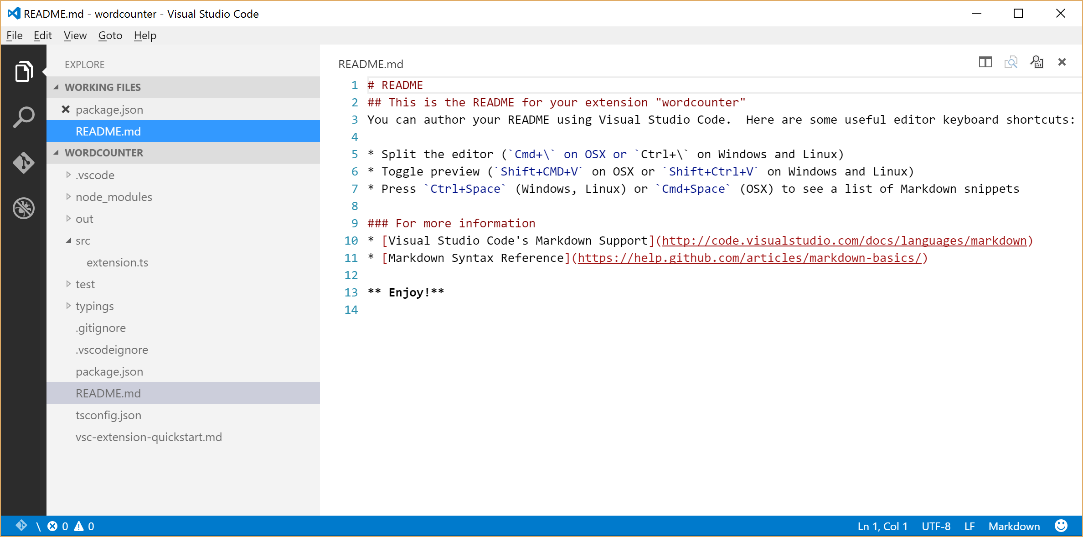
Master Builders Should Know the UI
Notes:
Ending…what’s important to see here – it’s incredibly simplistic, yet elegant. These are the basics – that’s it and that’s all. There’s no VS cruft here – just the basics.

Slide 10

Command Line Interfaces Make me Happy!
Run VS Code from the CLI, using “code”, with arguments:
Argument | Description
-r | open, using last active window
-n | open, using new window
-g | used with file:line:column, opens file at line and (optional) column position
file | open, if file doesn’t exist, creates the file
file:line:column | used with –g, opens file at line and (optional) column position
folder | name of folder to open
Notes:
If you’re a modern developer, you’re probably not spending a lot of time in GUIs, and you may be very familiar with the command line. That’s ok, and in fact, I think it’s more efficient. So, I think it’s important to highlight the CLI commands.

Slide 11
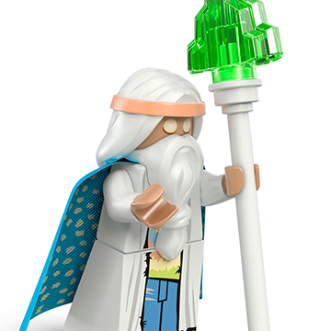
Master Builders Use the Command Palette
Command Palette = Chrome Omnibox
Search: Ctrl + P
Commands: Ctrl + Shift + P
Notes:
One of my favorite aspects of Chrome and other modern browsers is their ability to know exactly what I want – through the use of the Omnibox. I type in something and the system knows what I want.

Slide 12
Editing Code
Working Files
Side-by-Side Editing
Accordion UI
Language-specific UI
Auto Save
Command Palette
Notes:
"You've already how to open files, but there's more. Let’s take a look”

Slide 13

Follow the Plan by Running Tasks
Run Tasks from the Command Palette
Gulp, Make, Ant, MSBuild, Jake, & Rake
Notes:
In VS Code, there is deep integration with command-line task runners. Let’s take a look. I’m running gulp in my project.
Share Sample project – John Papa HotTowel – an opinionated way of writing Angular projects. It uses Yeoman to scaffold out a sample project, which is what I’m using for this demo.

Slide 14

Advanced Editing
Increase your Efficiency with these shortcuts
Emmet (http://emmet.io)
Multi Cursor
Content-aware Selection
Notes:
After our short detour to task runners, let’s come back to editing. The best person to help us here is Emmet, b/c VS Code leverages the Emmet.io project to help increase our efficiency in writing code. So let’s take a look at Emmet.io in action, plus some other cool features.

Slide 15

For the Visual Studio Fans
The best of VS is in VS Code
IntelliSense
Snippets
Goto & Peek
Group Text Movement

Slide 16

Debugging
VS Code has a Built-in Debugger
Node.js or Mono Debugging
Launching the Debugger
Debugging Profiles
Shortcut Keys
Notes:
VS Code offers a rich debugging environment similar to that of Visual Studio, but you can debug Node.js and Mono apps.

Slide 17

Customizing the Editor
Make VS Code Look and Feel Just Right
Change Color Themes (…as long at it’s Black or Dark Grey)
User Settings
Workspace Settings
Custom Key Bindings
Notes:
There are several things you can do to VS Code to make it your own

Slide 18
Extending VS Code
Step 1
Step 2
Step 3
npm install –g yo generator-code yo code
“F5” debug Command Palette: “Hello World”
cd extension-directory code . -n
Additional guides on writing VS Code extensions can be found at https://code.visualstudio.com/docs
Notes:
Extensions are the final area we’re going to look at tonight – they allow you to create you own functionality in VS Code.
There are some pre-reqs.

Slide 19


Thank You For Attending!
Twitter @mikebranstein Mail mike@brosteins.com Web brosteins.com & KiZAN.com

Slide 22
Why is Visual Studio Awesome?
Powerful IDE
Integrated Debugging
Extensibility
Team Collaboration
Multiple Languages
IntelliSense
Code Lens
F5 Debug
Remote Debugging
IntelliTrace
Add-ins
Extensions
TFS
TFVC
Git

Slide 23
text 2
text 1
text 3

Slide 25
Step 1
Step 2
Step 3

Slide 27


Slide 28



Slide 29


Slide 30
